Slide 1
OSS-Based
OSS Compliance Tooling
Siemens Corporate Technology 2019
CC-BY-SA-4.0

Slide 2
Agenda for Today - Morning
Topic | Presenting / Moderating | Time | Duration
Early Arrivers Meet and Greet | All | 09:30
Welcome and introduction round | Michael P. / Michael J. | 10:00 | 15
New members discussion: new proposals for new members Point for marketing of this effort, upcoming conferences | Michael J. / Michael P. | 10:15 | 30
Project Updates, 5 min per project except qmstr.org | Persons from the OSS Projects maybe 6 Projects in Total | 10:45 | 30
Coffee Break |  | 11:15 | 15
Project Updates continued |  |  | 15
EU Project Qmstr | Mirko | 12:15 | 15
Existing Proposal: OSCAR | Oliver | 12:00 | 15
Existing Proposals: ACT | Michael J. | 12:45 | 15
Lunch | All | 12:30 | 60

Slide 3
Agenda for Today - Afternoon
Topic | Presenting / Moderating | Time | Duration
Use Case Discussion | t.b.d. (SAP, Bosch, Siemens, ?) | 13:30 | 90
• Auto Compliance Check
• Component Clearing
• Security Assessment
Data model proposal | Oliver | 15:00 | 30
European Chapter of Todo group | Michael P. | 15:30 | 15
Coffee Break | All | 15:45
Security Efforts | SAP | 16:00 | 30
Wrap up and Closing | Michael P&J | 16:30-16:45 | 15

Slide 4
Welcome and
Introduction

Slide 5
Marketing,
New Members,
Upcoming Conferences

Slide 6
OSS-based OSS Compliance Tooling
Infrastructure
  Files at Github:
  https://github.com/Open-Source-Compliance/Sharing-creates-value
  Project Wiki:
  https://github.com/Open-Source-Compliance/Sharing-creates-value/wiki
  Mailinglist:
    https://groups.io/g/oss-based-compliance-tooling
    Please consider mailinglist: maintaining collection of E-Mails is really error-prone
    Mind that mailinglist is public

Slide 7
OSS-based OSS Compliance Tooling
New Members
  There were some interested from UK, Sweden
  More proposals?
  Onboarding would be easy, as there is public documentation

Slide 8
OSS-based OSS Compliance Tooling
Proposed Promotions
  Legal Workshop of FSFE
    Submitted general proposal (Mirko, Marcel, Oliver, Michael and Michael)
    Actually two other proposals were submitted with same / similar topic
  More conferences?

Slide 9
Project Updates
(about 5 mins each)

Slide 10
Project Updates - Quartermaster
(please see separate slides)
  qmstr.org

Slide 11
Project Updates – Open Source Review Toolkit
(please see separate slides)
  Github.com/here-maps/opensourcereviewtoolkit

Slide 12
Project Updates – Eclipse SW360Antenna
(please see separate slides)
  www.eclipse.org/sw360antenna

Slide 13
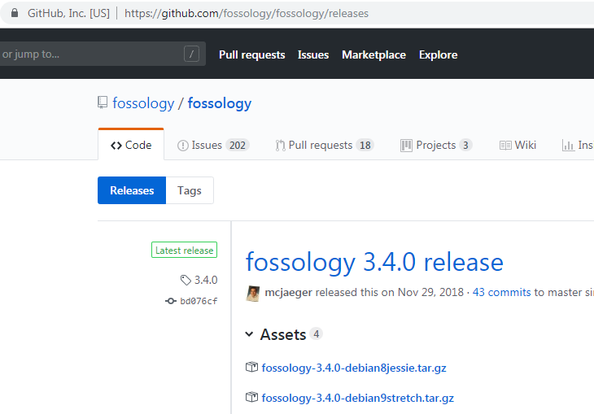
Project Updates - FOSSology
News since Last Meeting (Oct 2018)
  Release 3.4
  See release notes on GitHub
  Since then
    REST API
    UI Fixes
    Updates with SPDX 3.3 Lic List

Slide 14
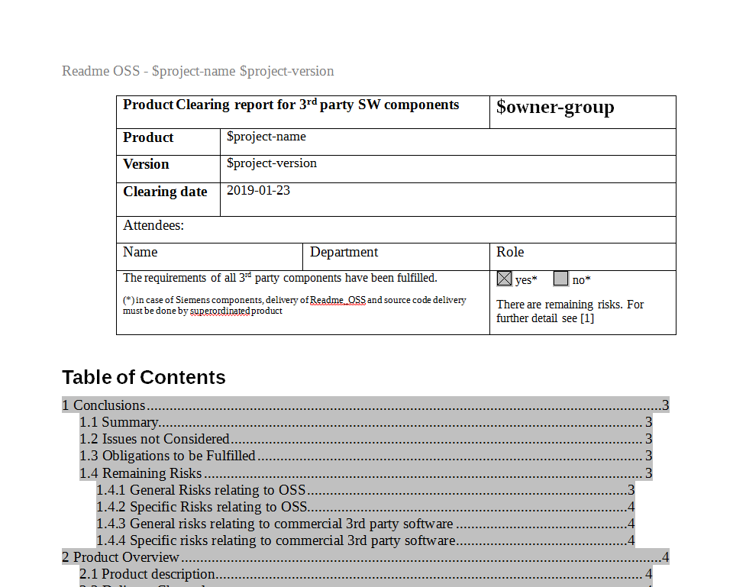
Project Updates - SW360 1 of 2
News since Last Meeting (Oct 2018)
  Work on product approval document
  Product approval:
    Do all components fit together?
    What is the big picture?
    What is the BOM?
    What are the total obligations?

Slide 15
Project Updates - SW360 2 of 2
Proposed Document Structure
2 Product Overview
2.1 Product Description
2.2 Delivery Channels
2.3 Development Details
2.4 Overview 3rd party components/services
3 Obligations
3.1 Common Rules
3.2 Additional Requirements
3.3 Disclosure Document
3.4 Build Instructions
3.5 Source Code Bundle
1 Conclusions
1.1 Summary
1.2 Issues not Considered
1.3 Obligations to be Fulfilled
1.4 Remaining Risks
1.4.1 General Risks relating to OSS
1.4.2 Specific Risks relating to OSS
1.4.3 General risks relating to commercial 3rd party software
1.4.4 Specific risks relating to commercial 3rd party software

Slide 16
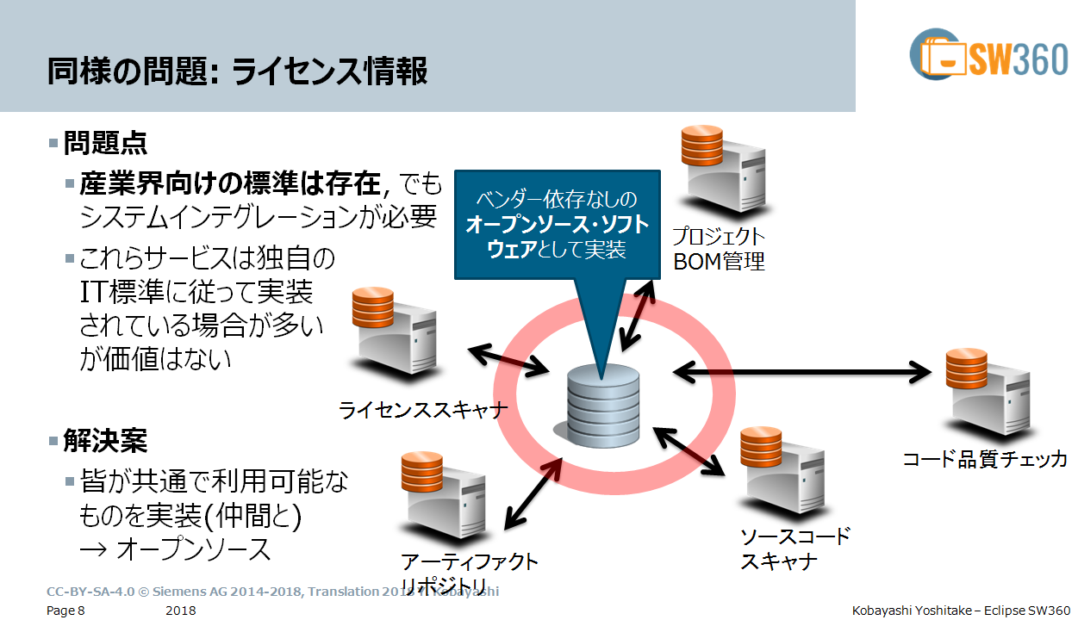
Project Updates - SW360
Japanese colleagues form the CIP
volunteer for slides:
https://github.com/sw360/sw360slides
English and Japanese Version
  Comprehensive set
  Please consider them
  for your presentations
  CC-BY-SA-4.0 licenses

Slide 17
Recently Granted
EU Research Project
On OSS

Slide 18
OSCAR at the
Eclipse Foundation

Slide 19
Eclipse Project OSCAR
(please see separate slides)
  oliver.fendt@siemens.com

Slide 20
ACT at the
Linux Foundation

Slide 21
Linux Foundation Project ACT
(please see separate slides)
  kstewart@linuxfundation.org

Slide 22
Lunch

Slide 23
Use Cases

Slide 24
Data Model
Proposal

Slide 25
Data Model Proposal
(please see separate slides)
  oliver.fendt@siemens.com

Slide 26
European Chapter
TODO Group

Slide 27
European Chapter of TODO Group
(please see separate slides)
  michael.picht@sap.com

Slide 28
Related Security
Efforts

Slide 29
Related Security Efforts
(please see separate slides)
  michael.picht@sap.com

Slide 30
Wrap Up and Closing

Slide 31
Wrap Up and Closing
Next meeting
  Anyone volunteering to host next meeting?
  Narrow down time frame for Doodleing
    Proposal: Before Legal Workshop of FSFE (10th of April)
Next Steps
  Refer to documentation

Slide 32
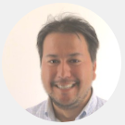
Thank you for your attention … questions?
Michael C. Jaeger
Siemens AG
Corporate Technology
Otto-Hahn-Ring 6
81379 München
michael.c.jaeger@siemens.com
FOSSology links
https://code.siemens.com/fossology/fossologyng
https://github.com/fossology/fossology
SW360 links
https://code.siemens.com/sw360/sw360portal
https://github.com/sw360/sw360portal

